Slide 1

Scaled Population Arithmetic for Efficient Stochastic Computing
Ruby Franco Martinez, 862222371 and Isabella Santiago, 862220109

Slide 2

Stochastic Computing
Background
Stochastic computing is when continuous values are represented by streams of randomly distributed bits and computations are performed.
Complex calculations can be done by using simple bitwise operations.
low-cost form of computing

Slide 3
Scaled Population Arithmetic for Stochastic Computing
Purpose: Multiplying 2 numbers between 0 and 1 using stochastic computing.
Use stochastic computing to convert the decimal number to binary.
Check if density is less than 50% in order to scale the binary number and then multiply.
Convert back into decimal and compare the results.

Slide 4
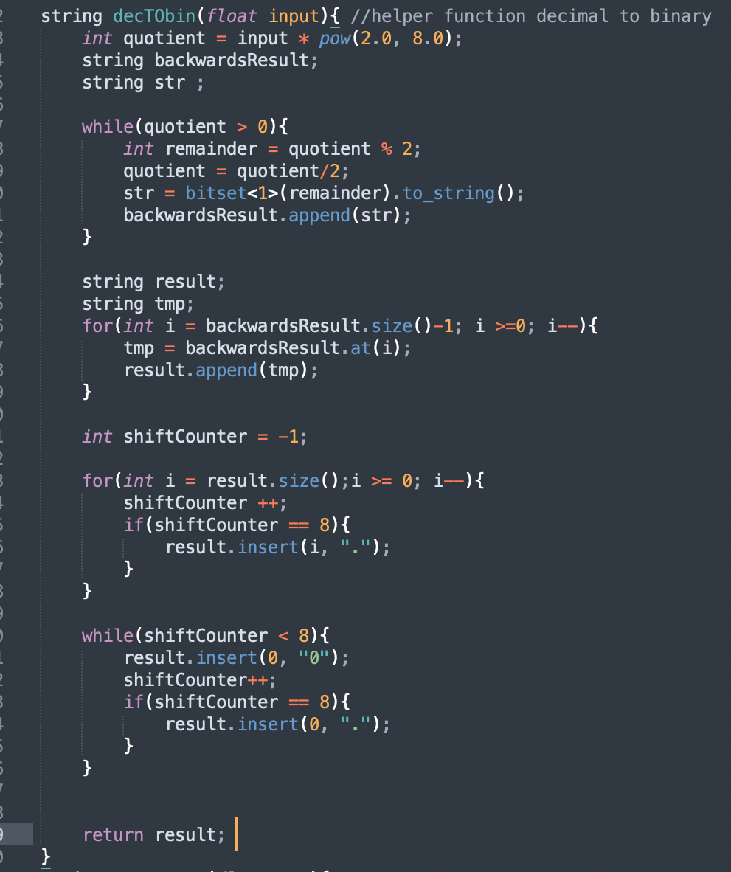
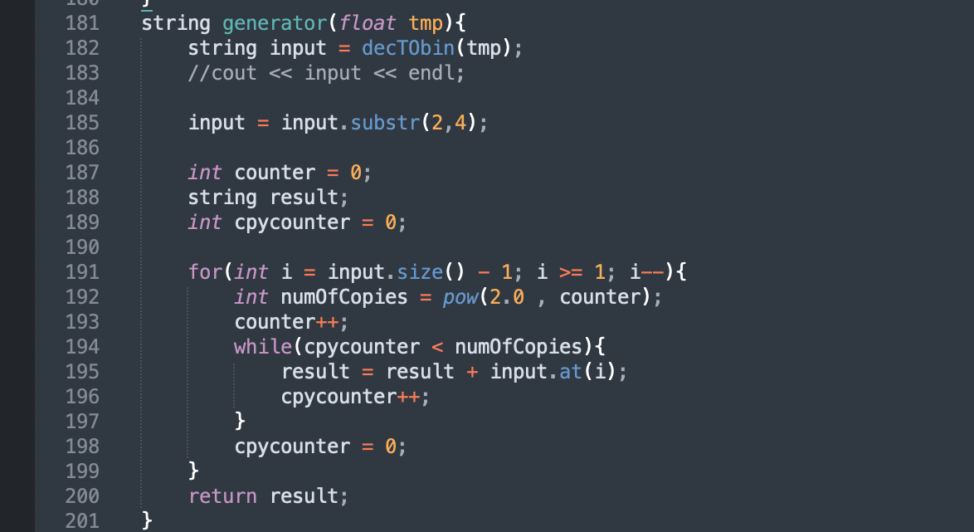
Program Overview
Key Functions
Generator
String function
Uses helper function
Generates new (σ, π)
Inputs (float)
decToBin
Helper function
Decimal to Binary

Slide 5
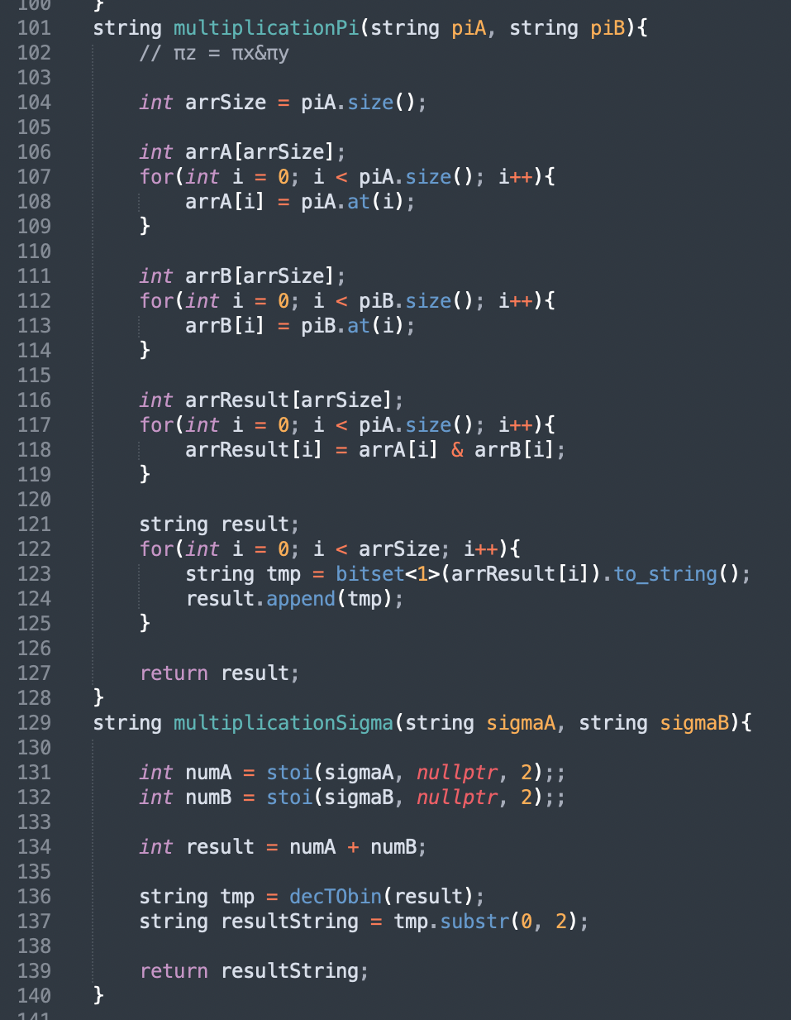
Program OverView
Multiplication
Calculates new pi and sigma
Key Features
Density Checker
Boolean function
Inputs (string σ, string π)
Checks density
Scaling Unit
Called only if density function failed
Outputs new Sigma and new Pi
Rescales (sigma, pi) to pass the density check

Slide 6
Program OverView
Key Features
numFormat
Parameters: 2 strings (sigma, pi)
Outputs float
Converts (sigma, pi) into a decimal
Addition
Functional but no longer used in the main purpose of this project
Main Function
Creates file input for 1,000 pairs
Creates data file output

Slide 7
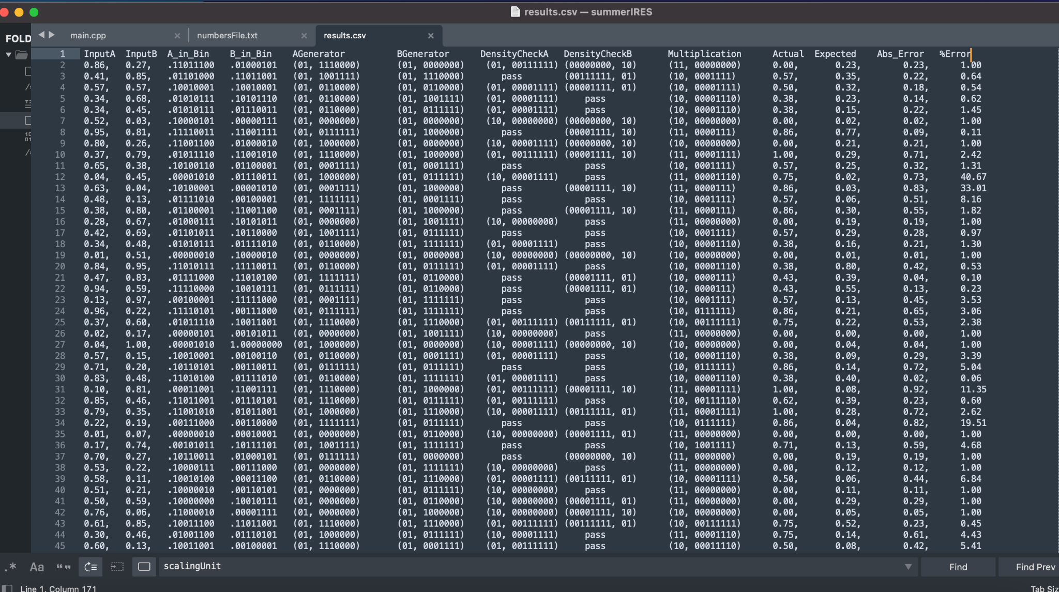
Experimental Results

Slide 8
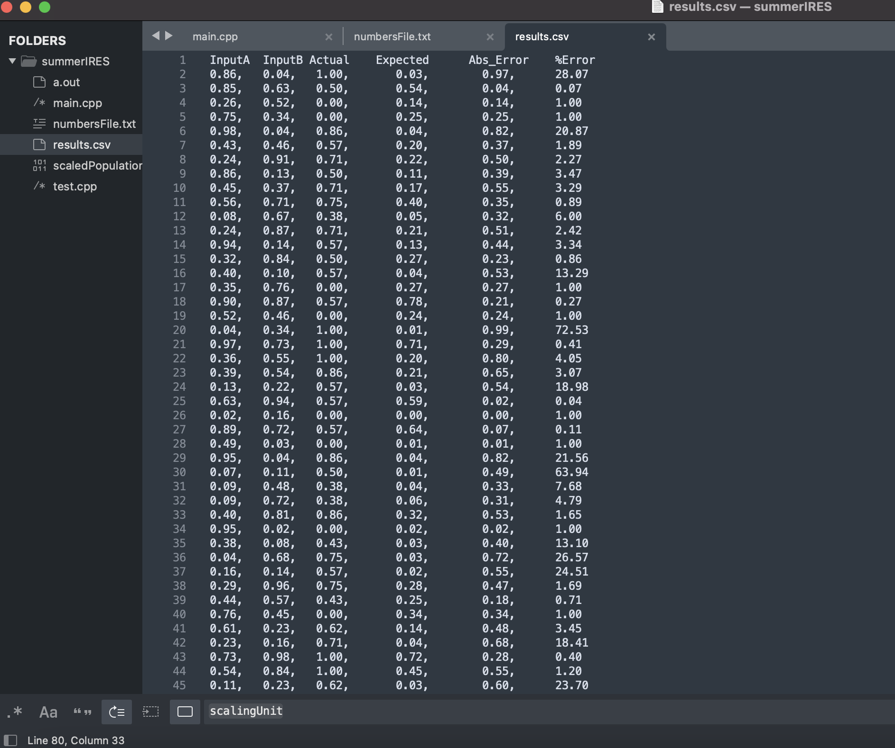
Experimental Results

Slide 9
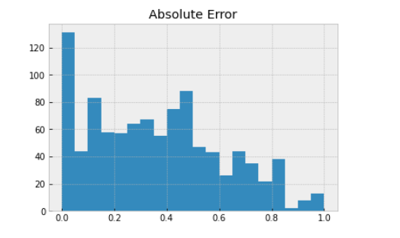
Absolute Error
Took the difference from actual (observed value) and expected value.

Slide 10
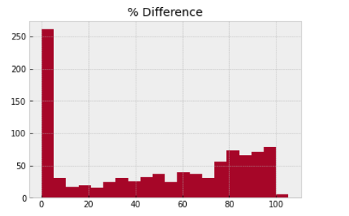
Percent Error
Percent Error = (|actual (observed value) - expected value|/ expected value )*100.

Slide 11
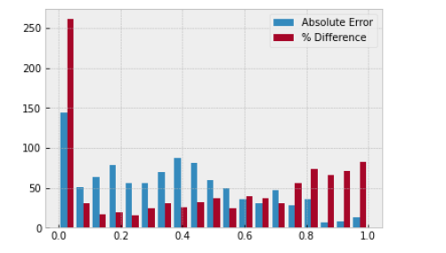
Error Graph
Combine both histograms in one graph

Slide 12
Conclusion
Overview
01
Stochastic Computing
Basics and Background
04
Experimental Results
What the experiment was and its comparison to previous models
02
Scaled Population for SC
Key features
05
Results and Graphs
Graphical Representation of our results
03
Program Overview
Key Functions of our program

